Slide 2
Refactoring into BDD / TDD for the future
Migrating a Magento 1 extension to Magento 2
Notes:
Hello and thank you for deciding to attend our presentation. Over the next 45 minutes we will walk you through porting a module from Magento 1 to Magento 2 while introducing TDD and BDD tools to ensure that the functionality of the modules still remains intact.

Slide 3
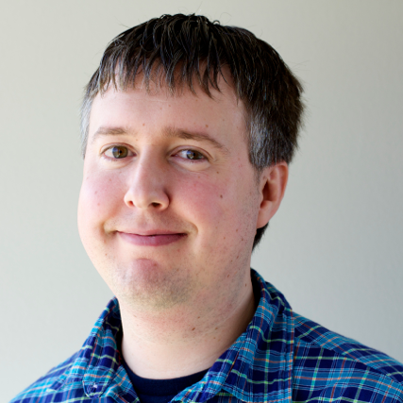
Joshua Warren
Creatuity
@JoshuaSWarren

Slide 4
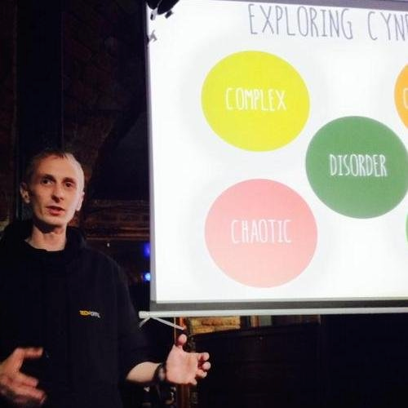
James Cowie
Session Digital
@JCowie
Notes:
Hello, Im James Cowie. I work for Session Digital in the UK where I am a software engineer focused mainly on E-Commerce and Magento. I have been working with Magento for the past 3 - 4 years and I have been a professional software engineer for the past 10 years. I am one of the maintainers of MageSpec and BehatMage and I have a real passion for BDD, And developing software that matters by using tools that can help make our lives easier and better.

Slide 5
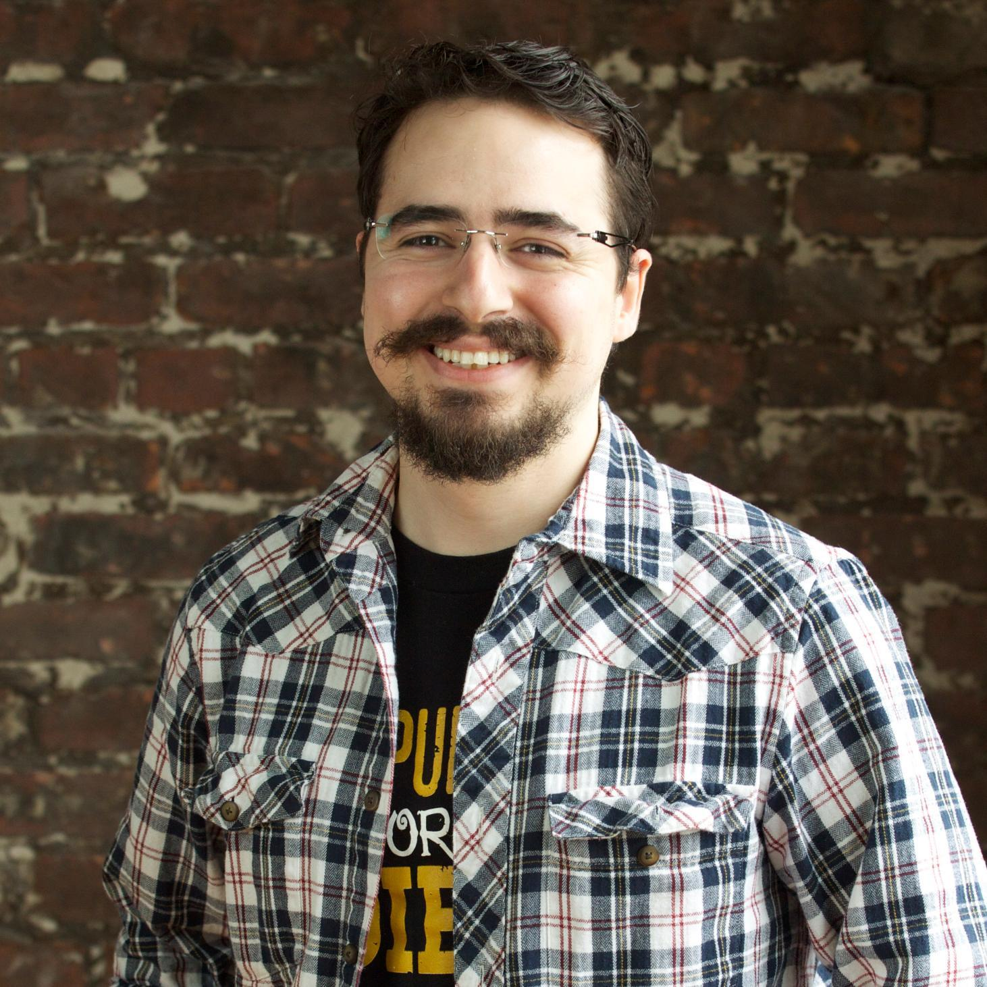
Allan MacGregor
Demac Media
@AllanMacGregor

Slide 6
Introduction to TDD
What is Test Driven Development
Notes:
So before we being porting the module and adding tests lets clear up some of the terms that we will be using.
How many people know and use TDD ( Test driven development ) in there jobs at the moment ?

Slide 7
What is Test Driven Development ( TDD )
Test
Design
20 min
Code
Notes:
Test Driven Development was first coined by Kent Beck in 2003.

Slide 8
Why is TDD Important ?
Focus on smaller units of code at a time
Improves Quality and reduces technical debt
SOLID

Slide 9
Introduction to BDD
What is Behaviour Driven Development

Slide 10
What is Behaviour Driven Development ( BDD )
Describe
Implement
How
Refactor

Slide 11
Why is BDD Important ?
Focus on business value
Ubiquitous Language

Slide 12
Introducing the tools
Overview of the tools we will use

Slide 13
Behat
Layer 1 testing that the functionality is the same

Slide 14
Behat
Test the UI
Selenium powered
Real in browser testing
Uses ubiquitous language
Test behaviour is the same

Slide 15
PHPUnit
Layer 2 testing the application level

Slide 16
PHPUnit
Unit tests for low level implementation
Integration tests between boundaries
Easier to apply to existing code than PHPSpec

Slide 17
PHPSpec
Layer 3 designing new code

Slide 18
PHPSpec
Design tool for new code
Suited for a test first approach

Slide 19
Migrating an Extension
How to introduce tests when migrating an extension

Slide 20
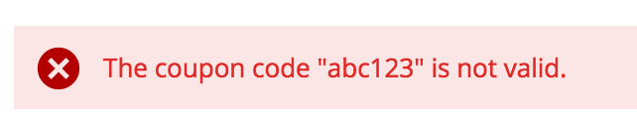
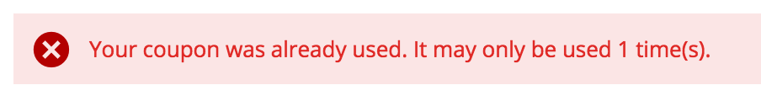
Migrating an extension from Magento 1 to Magento 2
https://github.com/magento-hackathon/Hackathon_PromoCodeMessages

Slide 21

Introducing Behat

Slide 22
}
"require-dev": { "behat/behat": "~3.0.13", "phpspec/phpspec": "~2.1.0-RC2", "phpunit/phpunit": "~4.5", "behat/mink": "~1.6.0", "behat/mink-extension": "~2.0.0", "behat/mink-selenium2-driver": "*", "peridot-php/webdriver-manager": "dev-master", "bossa/phpspec2-expect": "1.*", "magetest/magento": "2.0.1.*" },"require": {}, "extra": {}, "autoload": { "psr-0": { "Imagine\\Promocode": "src/", "Magento\\" : "vendor/magetest/magento/src/app/code/", "Magento\\Framework\\": "vendor/magetest/magento/src/lib/internal/" } }
Development
Testing

Slide 23
}
"require-dev": { "behat/behat": "~3.0.13", "phpspec/phpspec": "~2.1.0-RC2", "phpunit/phpunit": "~4.5", "behat/mink": "~1.6.0", "behat/mink-extension": "~2.0.0", "behat/mink-selenium2-driver": "*", "peridot-php/webdriver-manager": "dev-master", "bossa/phpspec2-expect": "1.*", "magetest/magento": "2.0.1.*" },"require": {}, "extra": {}, "autoload": { "psr-0": { "Imagine\\Promocode": "src/", "Magento\\" : "vendor/magetest/magento/src/app/code/", "Magento\\Framework\\": "vendor/magetest/magento/src/lib/internal/" } }
Development
Testing

Slide 24
Behat.yml
default:

Slide 25
Behat.yml
default: extensions: Behat\MinkExtension:

Slide 26
Behat.yml
default: extensions: Behat\MinkExtension: base_url: 'http://magento2.dev/' sessions: default: selenium2: wd_host: http://localhost:4444/wd/hub

Slide 27
Capturing the behaviour
Given
When
Then

Slide 28
Scenario: I have a coupon code that is valid but has not yet become activated Given I have a valid coupon code "SOMENEWPROMOCODE" When I try to redeem the coupon code Then I should see the error message "Your coupon is not valid yet. It will
be active on" Scenario: I have a coupon code that is no longer valid based on the current
date Given I have a valid coupon code "VOUCHERCODEDATE" When I try to redeem the coupon code Then I should see the error message "Your coupon is no longer valid. It
expired on" Scenario: I have a coupon code that has reached it's global usage limit Given I have a valid coupon code "VOUCHERCODE" When I try to redeem the coupon code Then I should see the error message "Your coupon was already used. It might
only be used"

Slide 29
Scenario: I have a coupon code that is valid but has not yet become activated Given I have a valid coupon code "SOMENEWPROMOCODE" When I try to redeem the coupon code Then I should see the error message "Your coupon is not valid yet. It will
be active on" Scenario: I have a coupon code that is no longer valid based on the current
date Given I have a valid coupon code "VOUCHERCODEDATE" When I try to redeem the coupon code Then I should see the error message "Your coupon is no longer valid. It
expired on" Scenario: I have a coupon code that has reached it's global usage limit Given I have a valid coupon code "VOUCHERCODE" When I try to redeem the coupon code Then I should see the error message "Your coupon was already used. It might
only be used"

Slide 30
Scenario: I have a coupon code that is valid but has not yet become activated Given I have a valid coupon code "SOMENEWPROMOCODE" When I try to redeem the coupon code Then I should see the error message "Your coupon is not valid yet. It will
be active on" Scenario: I have a coupon code that is no longer valid based on the current
date Given I have a valid coupon code "VOUCHERCODEDATE" When I try to redeem the coupon code Then I should see the error message "Your coupon is no longer valid. It
expired on" Scenario: I have a coupon code that has reached it's global usage limit Given I have a valid coupon code "VOUCHERCODE" When I try to redeem the coupon code Then I should see the error message "Your coupon was already used. It might
only be used"

Slide 31
Scenario: I have a coupon code that is valid but has not yet become activated Given I have a valid coupon code "SOMENEWPROMOCODE" When I try to redeem the coupon code Then I should see the error message "Your coupon is not valid yet. It will
be active on" Scenario: I have a coupon code that is no longer valid based on the current
date Given I have a valid coupon code "VOUCHERCODEDATE" When I try to redeem the coupon code Then I should see the error message "Your coupon is no longer valid. It
expired on" Scenario: I have a coupon code that has reached it's global usage limit Given I have a valid coupon code "VOUCHERCODE" When I try to redeem the coupon code Then I should see the error message "Your coupon was already used. It might
only be used"

Slide 32
Scenario: I have a coupon code that is valid but has not yet become activated Given I have a valid coupon code "SOMENEWPROMOCODE" When I try to redeem the coupon code Then I should see the error message "Your coupon is not valid yet. It will
be active on" Scenario: I have a coupon code that is no longer valid based on the current
date Given I have a valid coupon code "VOUCHERCODEDATE" When I try to redeem the coupon code Then I should see the error message "Your coupon is no longer valid. It
expired on" Scenario: I have a coupon code that has reached it's global usage limit Given I have a valid coupon code "VOUCHERCODE" When I try to redeem the coupon code Then I should see the error message "Your coupon was already used. It might
only be used"

Slide 33
Scenario: I have a coupon code that is valid but has not yet become activated Given I have a valid coupon code "SOMENEWPROMOCODE" When I try to redeem the coupon code Then I should see the error message "Your coupon is not valid yet. It will
be active on" Scenario: I have a coupon code that is no longer valid based on the current
date Given I have a valid coupon code "VOUCHERCODEDATE" When I try to redeem the coupon code Then I should see the error message "Your coupon is no longer valid. It
expired on" Scenario: I have a coupon code that has reached it's global usage limit Given I have a valid coupon code "VOUCHERCODE" When I try to redeem the coupon code Then I should see the error message "Your coupon was already used. It might
only be used"

Slide 34
Behat - - append-snippets

Slide 35
use Behat\Behat\Tester\Exception\PendingException; use Behat\Behat\Context\Context; use Behat\Behat\Context\SnippetAcceptingContext;
class FeatureContext implements Context, SnippetAcceptingContext {
/** * @Given I have a valid coupon code :couponCode */ public function iHaveAValidCouponCode($couponCode){ … }
}

Slide 36
use Behat\Behat\Tester\Exception\PendingException; use Behat\Behat\Context\Context; use Behat\Behat\Context\SnippetAcceptingContext;
use Behat\MinkExtension\Context\RawMinkContext;
class FeatureContext extends RawMinkContext implements Context, SnippetAcceptingContext {
private $couponCode; /** * @Given I have a valid coupon code :couponCode */ public function iHaveAValidCouponCode($couponCode) { $this->couponCode = $couponCode; }
}

Slide 37
Mink Context Intro
Provides abstraction for page interaction
Implementations for many methods
visit(URL)
find
fillField
click
doubleClick
uploadFile

Slide 38
/** * @Given I visit google.com and search for a string */ public function visitGoogleAndSearch() { $this->visitPath('/'); }
}
step
definition

Slide 39
/** * @Given I visit google.com and search for a string */ public function visitGoogleAndSearch() { $this->visitPath('/'); $this->getSession()->getPage()->fillField('search', 'BDD'); }

Slide 40
/** * @Given I visit google.com and search for a string */ public function visitGoogleAndSearch() { $this->visitPath('/'); $this->getSession()->getPage()->fillField('search', 'BDD'); $this->getSession()->getPage()->find('css', '.searchButton')->click(); }

Slide 41
Expect Lib ( Assertion Lib )
Additional Assertion lib for PHP
expect(some value)->to…(anotherValue)
toBe
toNotBe
toReturn
toNotReturn

Slide 42
use Behat\Behat\Tester\Exception\PendingException; use Behat\Behat\Context\Context; use Behat\Behat\Context\SnippetAcceptingContext;
use Behat\MinkExtension\Context\RawMinkContext;
class FeatureContext extends RawMinkContext implements Context, SnippetAcceptingContext {
private $couponCode; /** * @Given I have a valid coupon code :couponCode */ public function iHaveAValidCouponCode($couponCode) { $this->couponCode = $couponCode; }
}

Slide 43
/** * @When I try to redeem the coupon code */ public function iTryToUseRedeemTheCouponCode() { $this->visitPath('/joust-duffle-bag.html'); $this->getSession()->getPage()->find('css', '.tocart')->click(); $this->visitPath('/checkout/cart/'); $this->getSession()->getPage()
->fillField('coupon_code', $this->couponCode); $this->getSession()->getPage()
->find('xpath', ‘//*[@id="discount-coupon-form"]/div/div[2]/div/button')
->click(); }

Slide 44
/** * @When I try to redeem the coupon code */ public function iTryToUseRedeemTheCouponCode() { $this->visitPath('/joust-duffle-bag.html'); $this->getSession()->getPage()->find('css', '.tocart')->click(); $this->visitPath('/checkout/cart/'); $this->getSession()->getPage()
->fillField('coupon_code', $this->couponCode); $this->getSession()->getPage()
->find('xpath', ‘//*[@id="discount-coupon-form"]/div/div[2]/div/button')
->click(); }

Slide 45
/** * @When I try to redeem the coupon code */ public function iTryToUseRedeemTheCouponCode() { $this->visitPath('/joust-duffle-bag.html'); $this->getSession()->getPage()->find('css', '.tocart')->click(); $this->visitPath('/checkout/cart/'); $this->getSession()->getPage()
->fillField('coupon_code', $this->couponCode); $this->getSession()->getPage()
->find('xpath', ‘//*[@id="discount-coupon-form"]/div/div[2]/div/button')
->click(); }

Slide 46
/** * @When I try to redeem the coupon code */ public function iTryToUseRedeemTheCouponCode() { $this->visitPath('/joust-duffle-bag.html'); $this->getSession()->getPage()->find('css', '.tocart')->click(); $this->visitPath('/checkout/cart/'); $this->getSession()->getPage()
->fillField('coupon_code', $this->couponCode); $this->getSession()->getPage()
->find('xpath', ‘//*[@id="discount-coupon-form"]/div/div[2]/div/button')
->click(); }

Slide 47
/** * @When I try to redeem the coupon code */ public function iTryToUseRedeemTheCouponCode() { $this->visitPath('/joust-duffle-bag.html'); $this->getSession()->getPage()->find('css', '.tocart')->click(); $this->visitPath('/checkout/cart/'); $this->getSession()->getPage()
->fillField('coupon_code', $this->couponCode); $this->getSession()->getPage()
->find('xpath', ‘//*[@id="discount-coupon-form"]/div/div[2]/div/button')
->click(); }

Slide 48
/** * @Then I should see the error message :message */ public function iShouldSeeTheErrorMessage($message) { $output = $this->getSession()->getPage()
->find('css', ‘.message-error')
->getText(); expect($output)->toBe($message); }

Slide 49
/** * @Then I should see the error message :message */ public function iShouldSeeTheErrorMessage($message) { $output = $this->getSession()->getPage()
->find('css', ‘.message-error')
->getText(); expect($output)->toBe($message); }

Slide 50

Module Structure

Slide 51
Setting up the Magento 2 module
Git project outside of Magento
composer.json
Requires Magento2 so we can mock dependencies

Slide 52
Imagine/Promocode
src
spec
tests
features
bin
vendor
Imagine/Promocode
composer.json
etc
Model
module.xml
Observer.php
events.xml
Validator.php
Validators
GlobalValidator.php
DateValidator.php

Slide 53
module.xml
<?xml version="1.0"?> <config xmlns:xsi="http://www.w3.org/2001/XMLSchema-instance" xsi:noNamespaceSchemaLocation=
"../../../../../lib/internal/Magento/Framework/Module/etc/module.xsd"> <module name="Imagine_Promocode" schema_version="1.0.0"> </module> </config>

Slide 54
events.xml
<?xml version="1.0"?> <config xmlns:xsi="http://www.w3.org/2001/XMLSchema-instance" xsi:noNamespaceSchemaLocation
="../../../../../../lib/internal/Magento/Framework/Event/etc/events.xsd"> <event name="sales_quote_collect_totals_after"> <observer name="promocode"
instance="Imagine\Promocode\Model\Observer"
method="execute" /> </event> </config>

Slide 55
Quick Recap

Slide 56
What do we need to port over ?
Observer file
Validator
Validators..
Date Validator
Global Validator

Slide 57

Introducing PHPSpec

Slide 58
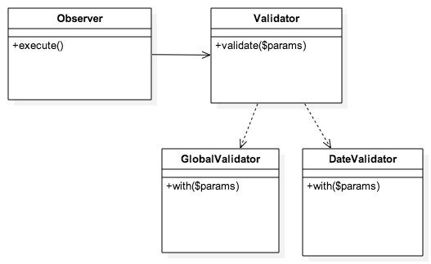

Slide 59
Describe the Validator
phpspec describe Imagine/Promocode/Model/Validator

Slide 60
Describe the Validator
phpspec describe Imagine/Promocode/Model/Validator
function it_is_initializable() { $this->shouldHaveType('Imagine\Promocode\Model\Validator'); }

Slide 61
Describe our date validator
ValidatorSpec.php
function it_should_validate_and_throw_exception_invalid_date( \Magento\SalesRule\Model\Rule $rule, \Magento\SalesRule\Model\Coupon $coupon ) { $rule->getFromDate()->willReturn('2017-01-01'); $params = array( 'rule' => $rule, 'coupon' => $coupon ); $exception = new \Exception(
'Your coupon is not valid yet. It will be active on 2017-01-01'); $this->shouldThrow($exception)->duringValidate($params); }

Slide 62
Describe our date validator
ValidatorSpec.php
function it_should_validate_and_throw_exception_invalid_date( \Magento\SalesRule\Model\Rule $rule, \Magento\SalesRule\Model\Coupon $coupon ) { $rule->getFromDate()->willReturn('2017-01-01'); $params = array( 'rule' => $rule, 'coupon' => $coupon ); $exception = new \Exception(
'Your coupon is not valid yet. It will be active on 2017-01-01'); $this->shouldThrow($exception)->duringValidate($params); }
doubles

Slide 63
Describe our date validator
ValidatorSpec.php
function it_should_validate_and_throw_exception_invalid_date( \Magento\SalesRule\Model\Rule $rule, \Magento\SalesRule\Model\Coupon $coupon ) { $rule->getFromDate()->willReturn('2017-01-01'); $params = array( 'rule' => $rule, 'coupon' => $coupon ); $exception = new \Exception(
'Your coupon is not valid yet. It will be active on 2017-01-01'); $this->shouldThrow($exception)->duringValidate($params); }
State

Slide 64
Describe our date validator
ValidatorSpec.php
function it_should_validate_and_throw_exception_invalid_date( \Magento\SalesRule\Model\Rule $rule, \Magento\SalesRule\Model\Coupon $coupon ) { $rule->getFromDate()->willReturn('2017-01-01'); $params = array( 'rule' => $rule, 'coupon' => $coupon ); $exception = new \Exception(
'Your coupon is not valid yet. It will be active on 2017-01-01'); $this->shouldThrow($exception)->duringValidate($params); }
outcome

Slide 65
Describe the Date Validator
phpspec d Imagine/Promocode/Model/Validator/DateValidator
function let() { $this->beConstructedThrough('validate', []); }

Slide 66
Describe the Date Validator
phpspec d Imagine/Promocode/Model/Validator/DateValidator
function it_should_throw_an_invalid_date_exception( \Magento\SalesRule\Model\Rule $rule, \Magento\Sales\Model\Quote $quote ) { $rule->getFromDate()->willReturn('2017-01-01'); $params = array('rule' => $rule); $exception = new \Exception(
'Your coupon is not valid yet. It will be active on 2017-01-01
‘);
$this->shouldThrow($exception)->duringWith($params); }

Slide 67
Describe the Date Validator
phpspec d Imagine/Promocode/Model/Validator/DateValidator
function it_should_throw_an_invalid_date_exception( \Magento\SalesRule\Model\Rule $rule, \Magento\Sales\Model\Quote $quote ) { $rule->getFromDate()->willReturn('2017-01-01'); $params = array('rule' => $rule); $exception = new \Exception(
'Your coupon is not valid yet. It will be active on 2017-01-01
‘);
$this->shouldThrow($exception)->duringWith($params); }
doubles

Slide 68
Describe the Date Validator
phpspec d Imagine/Promocode/Model/Validator/DateValidator
function it_should_throw_an_invalid_date_exception( \Magento\SalesRule\Model\Rule $rule, \Magento\Sales\Model\Quote $quote ) { $rule->getFromDate()->willReturn('2017-01-01'); $params = array('rule' => $rule); $exception = new \Exception(
'Your coupon is not valid yet. It will be active on 2017-01-01
‘);
$this->shouldThrow($exception)->duringWith($params); }
Setting Expectations

Slide 69
Describe the Date Validator
phpspec d Imagine/Promocode/Model/Validator/DateValidator
function it_should_throw_an_invalid_date_exception( \Magento\SalesRule\Model\Rule $rule, \Magento\Sales\Model\Quote $quote ) { $rule->getFromDate()->willReturn('2017-01-01'); $params = array('rule' => $rule); $exception = new \Exception(
'Your coupon is not valid yet. It will be active on 2017-01-01
‘);
$this->shouldThrow($exception)->duringWith($params); }
outcome

Slide 70
Generated Data Validator
phpspec run
<?php namespace Imagine\Promocode\Model\Validator; class DateValidator { public static function validate() { $dateValidator = new DateValidator; return $dateValidator; } public function with($params) { } }

Slide 71
Date Validator
public function with($params)
{ $rule = $params['rule']; if ($rule->getFromDate()) { $fromDate = new \Carbon\Carbon($rule->getFromDate()); if (\Carbon\Carbon::now()->lte($fromDate)) { $message = sprintf(
'Your coupon is not valid yet. It will be active on %s',
$fromDate->toDateString()
);
throw new \Exception($message); } } }

Slide 72
Date Validator
Array of posible objects
public function with($params)
{ $rule = $params['rule']; if ($rule->getFromDate()) { $fromDate = new \Carbon\Carbon($rule->getFromDate()); if (\Carbon\Carbon::now()->lte($fromDate)) { $message = sprintf(
'Your coupon is not valid yet. It will be active on %s',
$fromDate->toDateString()
);
throw new \Exception($message); } } }

Slide 73
Date Validator
public function with($params)
{ $rule = $params['rule']; if ($rule->getFromDate()) { $fromDate = new \Carbon\Carbon($rule->getFromDate()); if (\Carbon\Carbon::now()->lte($fromDate)) { $message = sprintf(
'Your coupon is not valid yet. It will be active on %s',
$fromDate->toDateString()
);
throw new \Exception($message); } } }

Slide 74
Update composer.json
"require": { "nesbot/carbon": "~1.18" }, "extra": { }, "autoload": { "psr-0": { "Carbon\\": "vendor/nesbot/carbon/src/" } }

Slide 75
Describe the Global Validator
phpspec d Imagine/Promocode/Model/Validator/globalvalidator
function let() { $this->beConstructedThrough('validate', []); }

Slide 76
Describe the Global Validator
phpspec d Imagine/Promocode/Model/Validator/globalvalidator
function
it_should_throw_an_exception_for_coupons_used_more_than_specified_usage_limit
(
\Magento\SalesRule\Model\Coupon $coupon
) { $coupon->getUsageLimit()->willReturn(1); $coupon->getTimesUsed()->willReturn(1); $params = array('coupon' => $coupon); $exception = new \Exception(
'Your coupon was already used. It may only be used 1 time(s).’
); $this->shouldThrow($exception)->duringWith($params); }

Slide 77
Describe the Global Validator
phpspec d Imagine/Promocode/Model/Validator/globalvalidator
function
it_should_throw_an_exception_for_coupons_used_more_than_specified_usage_limit
(
\Magento\SalesRule\Model\Coupon $coupon
) { $coupon->getUsageLimit()->willReturn(1); $coupon->getTimesUsed()->willReturn(1); $params = array('coupon' => $coupon); $exception = new \Exception(
'Your coupon was already used. It may only be used 1 time(s).’
); $this->shouldThrow($exception)->duringWith($params); }
Mocked coupon class

Slide 78
Describe the Global Validator
phpspec d Imagine/Promocode/Model/Validator/globalvalidator
function
it_should_throw_an_exception_for_coupons_used_more_than_specified_usage_limit
(
\Magento\SalesRule\Model\Coupon $coupon
) { $coupon->getUsageLimit()->willReturn(1); $coupon->getTimesUsed()->willReturn(1); $params = array('coupon' => $coupon); $exception = new \Exception(
'Your coupon was already used. It may only be used 1 time(s).’
); $this->shouldThrow($exception)->duringWith($params); }
setting values on the mock

Slide 79
Describe the Global Validator
phpspec d Imagine/Promocode/Model/Validator/globalvalidator
function
it_should_throw_an_exception_for_coupons_used_more_than_specified_usage_limit
(
\Magento\SalesRule\Model\Coupon $coupon
) { $coupon->getUsageLimit()->willReturn(1); $coupon->getTimesUsed()->willReturn(1); $params = array('coupon' => $coupon); $exception = new \Exception(
'Your coupon was already used. It may only be used 1 time(s).’
); $this->shouldThrow($exception)->duringWith($params); }
assertions

Slide 80
Generated Global Validator
phpspec run
<?php namespace Imagine\Promocode\Model\Validator; class GlobalValidator { public static function validate() { $globalValidator = new GlobalValidator(); return $globalValidator; } public function with($params) { } }

Slide 81
Global Validator
public function with($params) { $coupon = $params['coupon']; if ($coupon->getUsageLimit() &&
$coupon->getTimesUsed() >= $coupon->getUsageLimit()) { $message = sprintf( 'Your coupon was already used. It may only be used %s time(s).', $coupon->getUsageLimit() ); throw new \Exception($message); } }

Slide 82
Use our Validators
Validator.php
<?php namespace Imagine\Promocode\Model; use \Imagine\Promocode\Model\Validator\GlobalValidator as GlobalValidator; use \Imagine\Promocode\Model\Validator\DateValidator as DateValidator; class Validator { public function validate($params) { GlobalValidator::validate()->with($params); DateValidator::validate()->with($params); } }

Slide 83
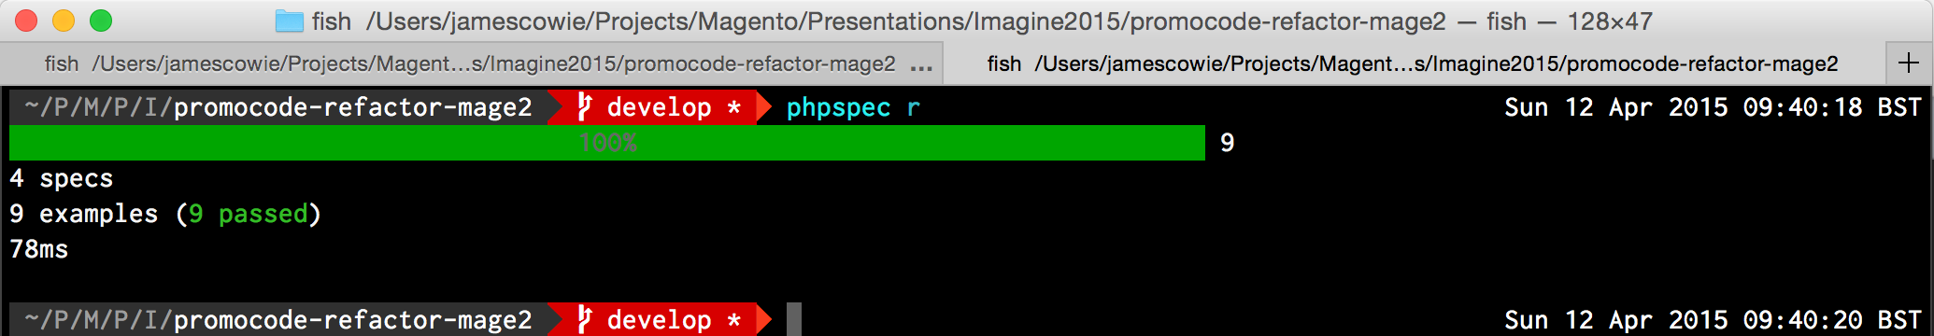
Run PHPSpec

Slide 84

Introducing PHPUnit

Slide 85
Configure PHPUnit
<?xml version="1.0" encoding="utf-8" ?> <phpunit bootstrap="./vendor/autoload.php"> <testsuites> <testsuite name="Project test suite"> <directory>./tests</directory> </testsuite> </testsuites> </phpunit>

Slide 86
Setting up PHPUnit
<?php class ObserverTest extends PHPUnit_Framework_TestCase {
…
}

Slide 87
Setting up PHPUnit
private $observer;
protected function setup() { $this->observer = new \Imagine\Promocode\Model\Observer(
$this->rule, $quote,
$this->coupon); }

Slide 88
/** * @expectedException Exception * @expectedExceptionMessage Your coupon was already used. It may only be
used 1 time(s). */ public function testValidateCoupon() {
}

Slide 89
PHPUnit set up
Creating Mocks
private $coupon;
protected function setup() {
$this->coupon = $this->getMockBuilder('\Magento\SalesRule\Model\Coupon') ->setMethods(array('getUsageLimit', 'loadByCode','getTimesUsed')) ->disableOriginalConstructor() ->getMock();
$this->observer = new \Imagine\Promocode\Model\Observer($this->coupon);
}
public function testValidateCoupon() { $this->coupon->method('getUsageLimit')->willReturn(1); $this->coupon->method('getTimesUsed')->willReturn(2); }

Slide 90
PHPUnit
Setting values on the mocks
private $coupon;
protected function setup() {
$this->coupon = $this->getMockBuilder('\Magento\SalesRule\Model\Coupon') ->setMethods(array('getUsageLimit', 'loadByCode','getTimesUsed')) ->disableOriginalConstructor() ->getMock();
$this->observer = new \Imagine\Promocode\Model\Observer($this->coupon);
}
public function testValidateCoupon() { $this->coupon->method('getUsageLimit')->willReturn(1); $this->coupon->method('getTimesUsed')->willReturn(2); }

Slide 91
Execute our method
public function testValidateCoupon() { $this->coupon->method('getUsageLimit')->willReturn(1); $this->coupon->method(‘getTimesUsed')->willReturn(2);
$this->observer->execute($observer);
}

Slide 92
public function testValidateCoupon() { $quote = $this->getMockBuilder('\Magento\Sales\Model\Quote') ->disableOriginalConstructor() ->getMock(); $quote->expects($this->any()) ->method('getCouponCode') ->willReturn('testCode');
}

Slide 93
public function testValidateCoupon() {
…
$observer = $this->getMockBuilder('\Magento\Framework\Event\Observer') ->setMethods(array('getEvent', 'getQuote')) ->getMock(); $observer->expects($this->any()) ->method('getEvent') ->will($this->returnSelf()); $observer->expects($this->any()) ->method('getQuote') ->willReturn($quote);
… }

Slide 94
public function testValidateCoupon() {
…
$this->coupon->method('loadByCode') ->willReturn($this->coupon);
… }

Slide 95
public function setup() {
…
$this->rule = $this->getMockBuilder('\Magento\SalesRule\Model\Rule') ->setMethods(array('getFromDate')) ->disableOriginalConstructor() ->getMock();
$this->observer = new \Imagine\Promocode\Model\Observer(
$this->rule,
$this->coupon
);
… }

Slide 96
public function setup() {
$quote = $this->getMockBuilder('\Magento\Sales\Model\Quote') ->setMethods(array('getCouponCode')) ->disableOriginalConstructor() ->getMock(); $quote->expects($this->any()) ->method('getCouponCode') ->willReturn('testCode');
$this->observer = new \Imagine\Promocode\Model\Observer(
$this->rule,
$quote,
$this->coupon
);

Slide 97
Installing the module

Slide 98
Configuring Project Composer.json
"repositories": [ { "type": "composer", "url": "http://packages.magento.com" }, { "type": "git", "url": "https://github.com/amacgregor/promocode-refactor-mage2.git" } ]

Slide 99
Configuring Project Composer.json
"require": { … "amacgregor/promocode": "dev-develop" },

Slide 100
Any Questions ?

